Slide 1
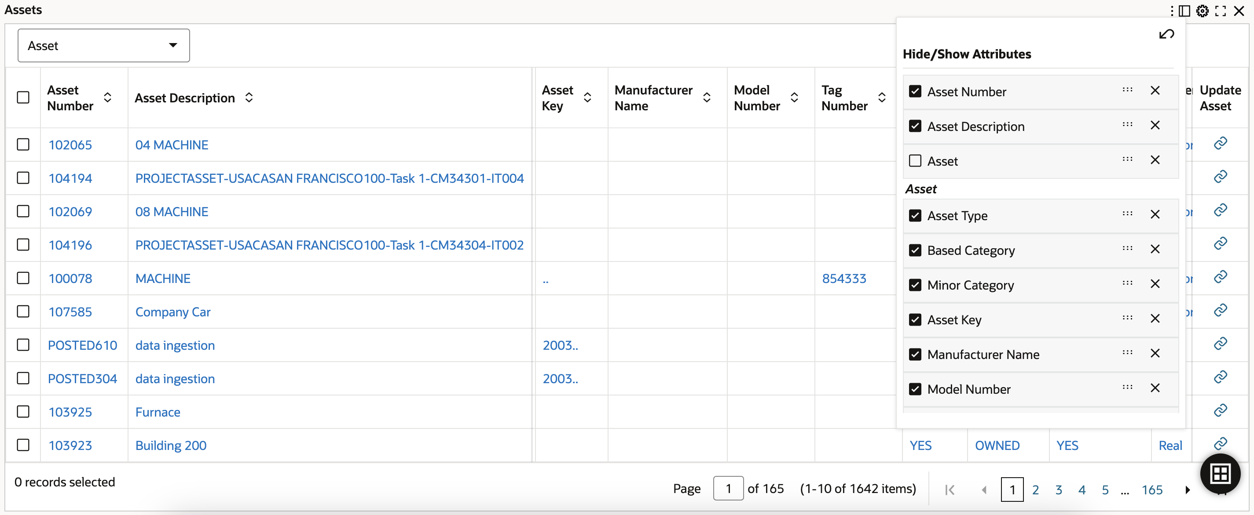



Slide 2
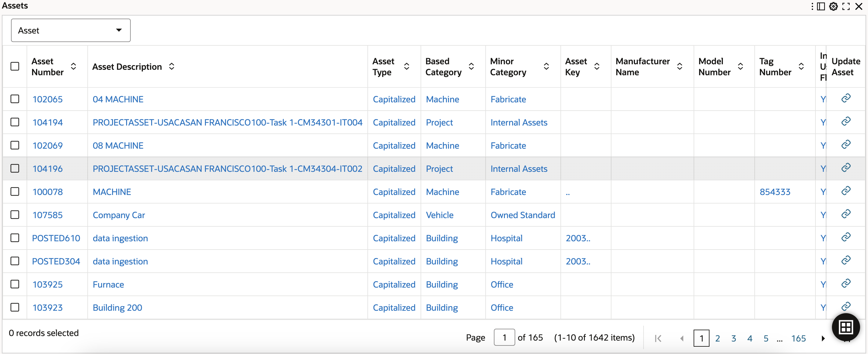
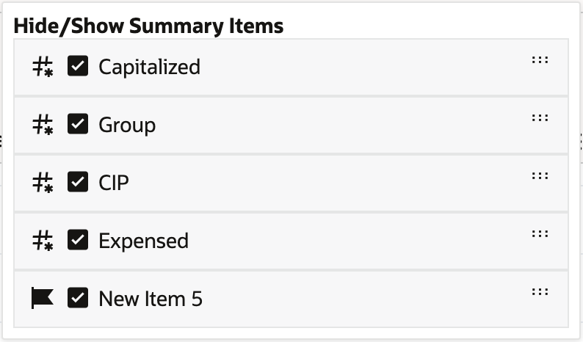






Slide 3

1

Slide 5
1

Slide 6
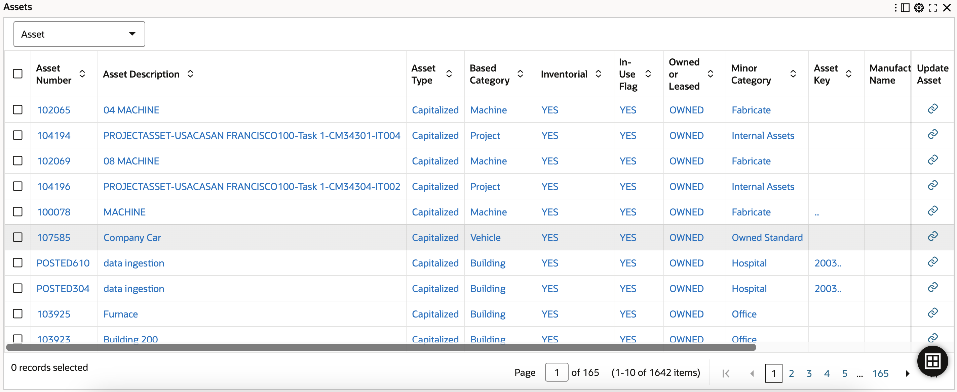

1

Slide 8
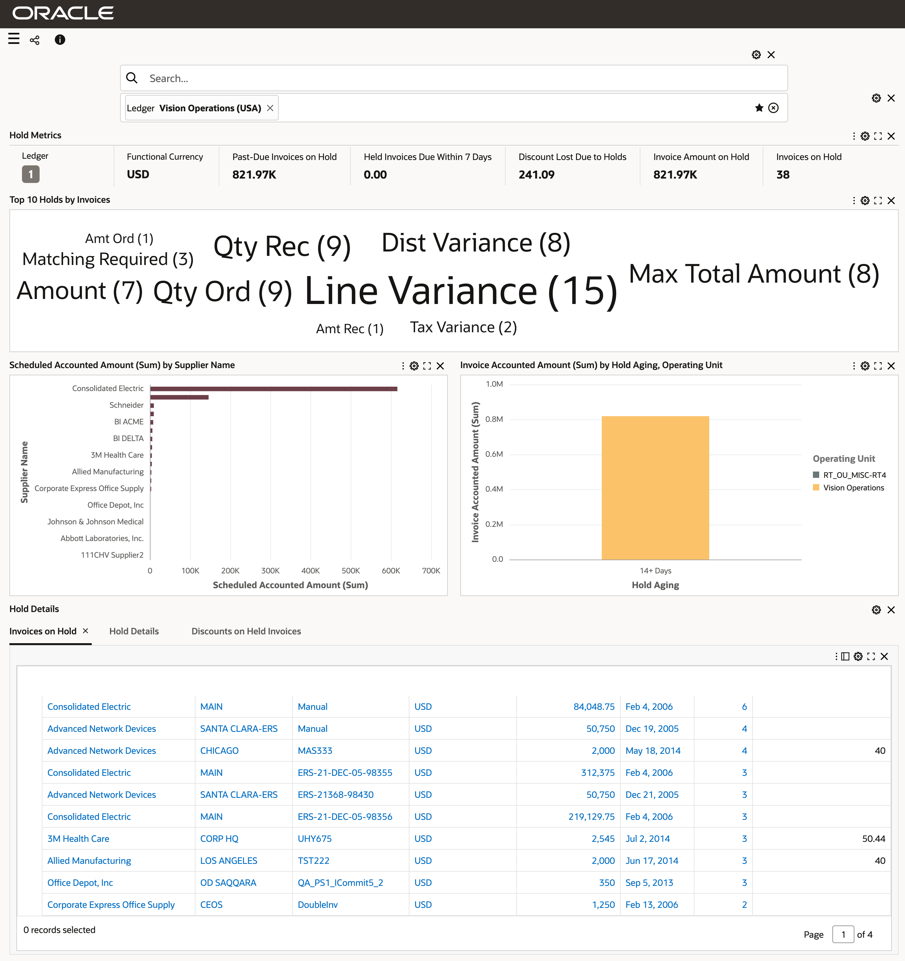
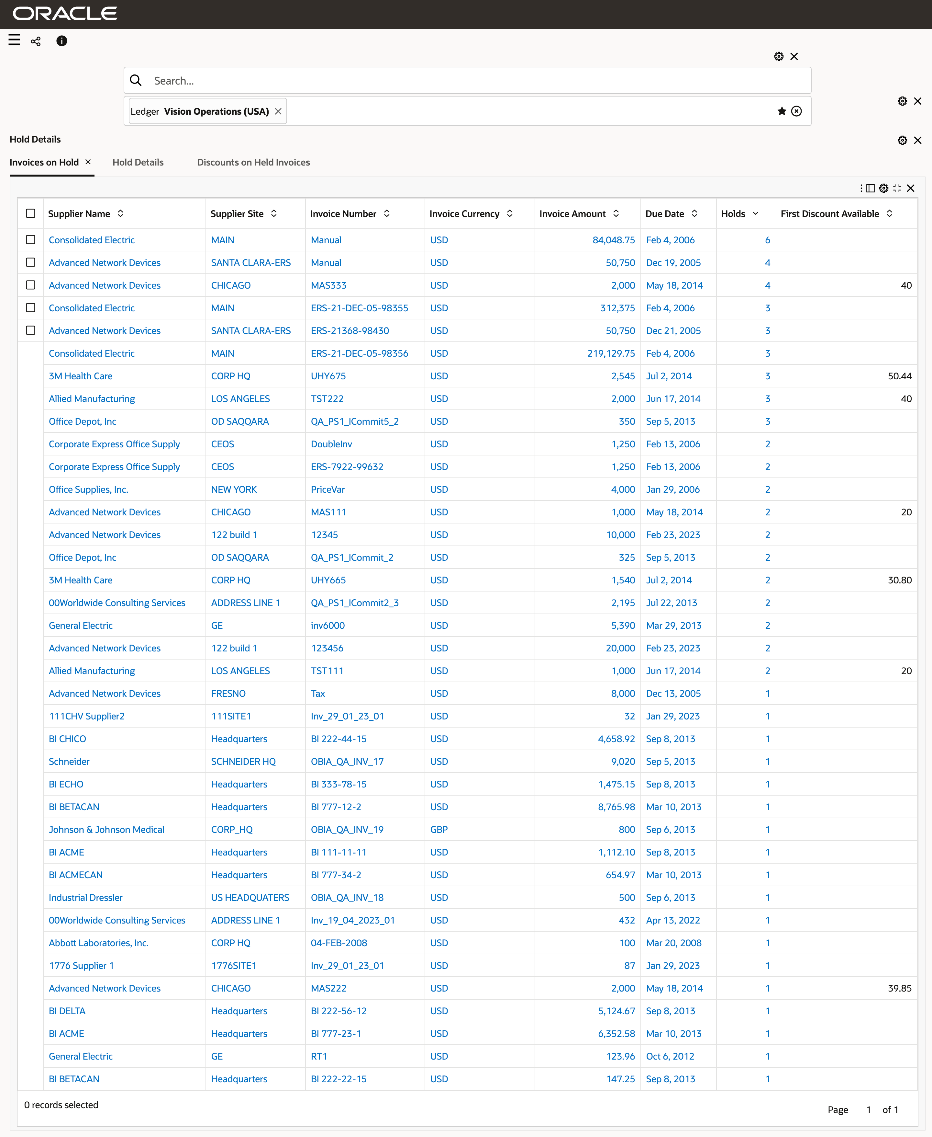

Slide 11
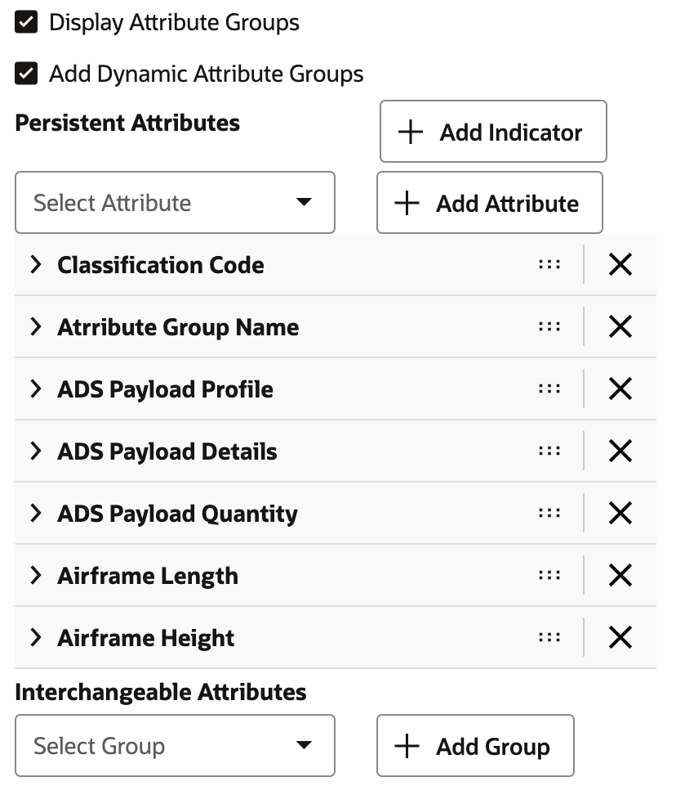

Slide 12
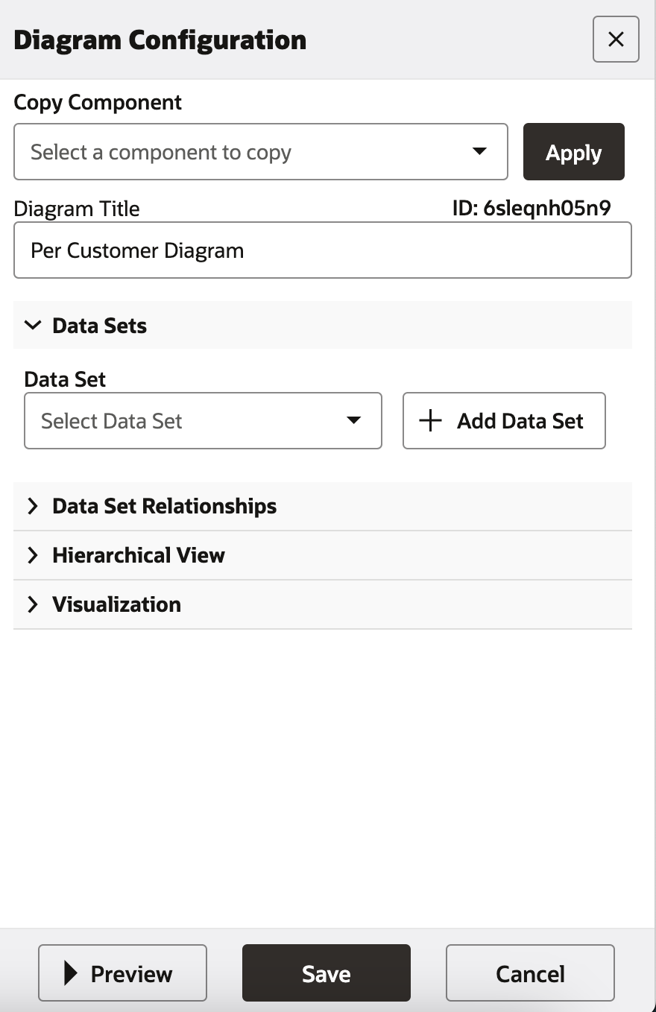

Slide 13
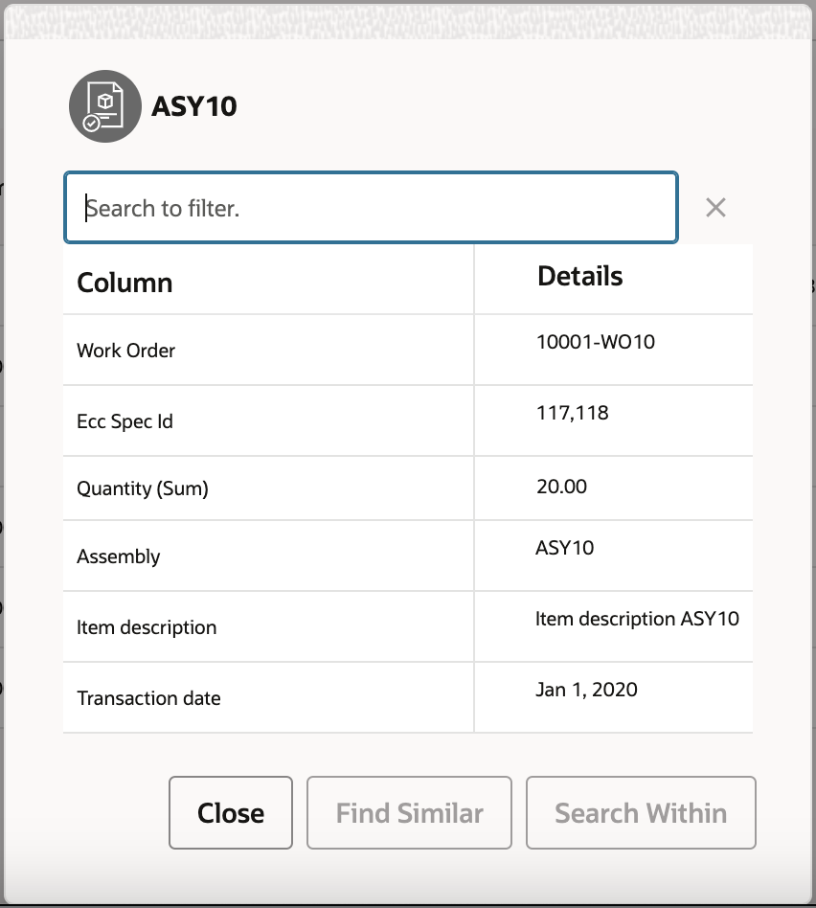



Slide 16
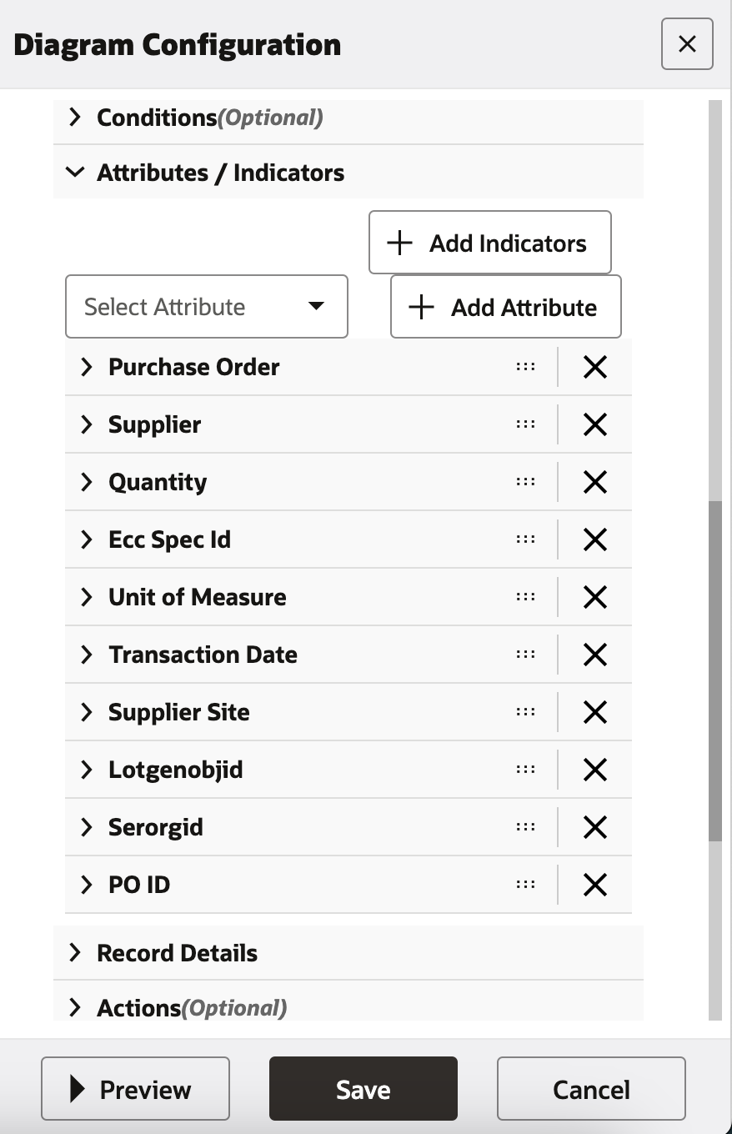


Slide 18
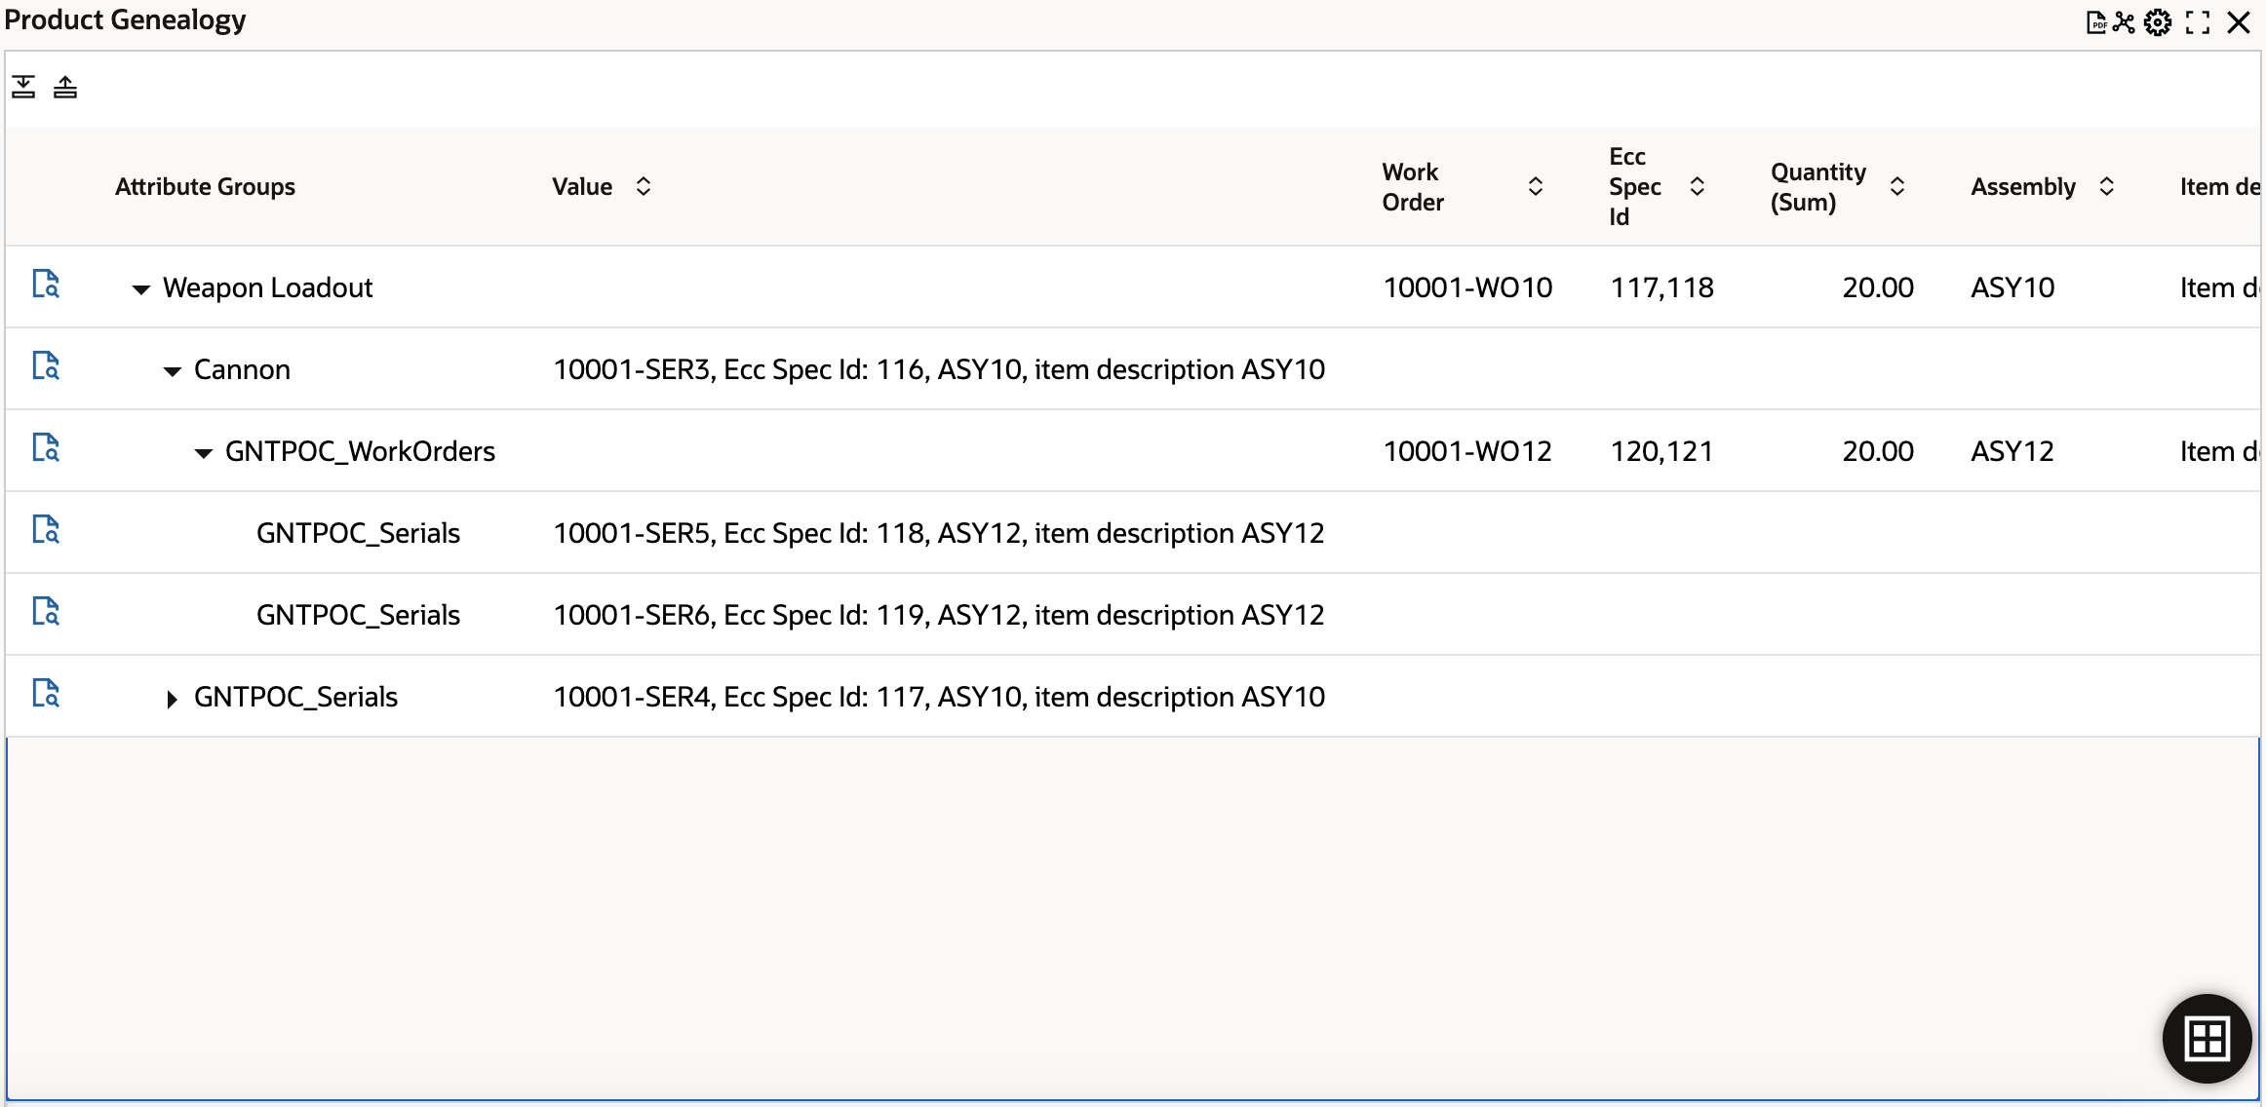
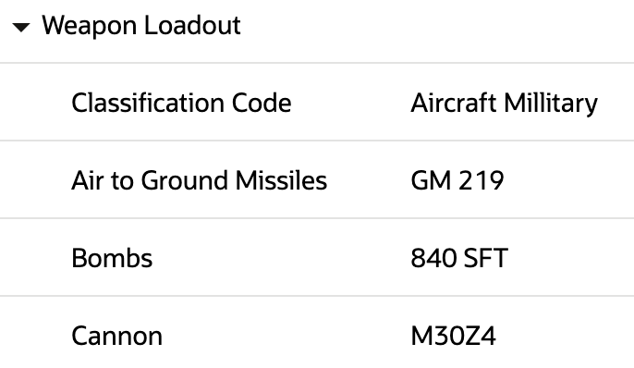
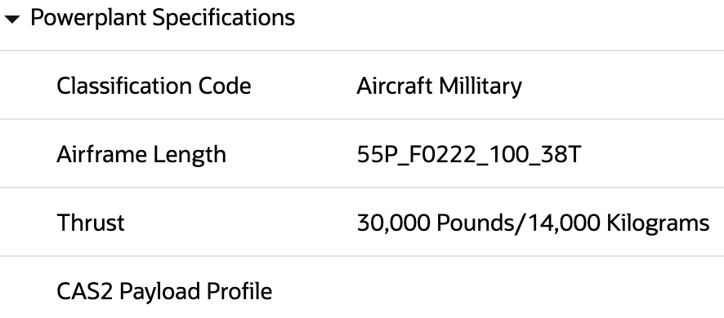

Slide 19
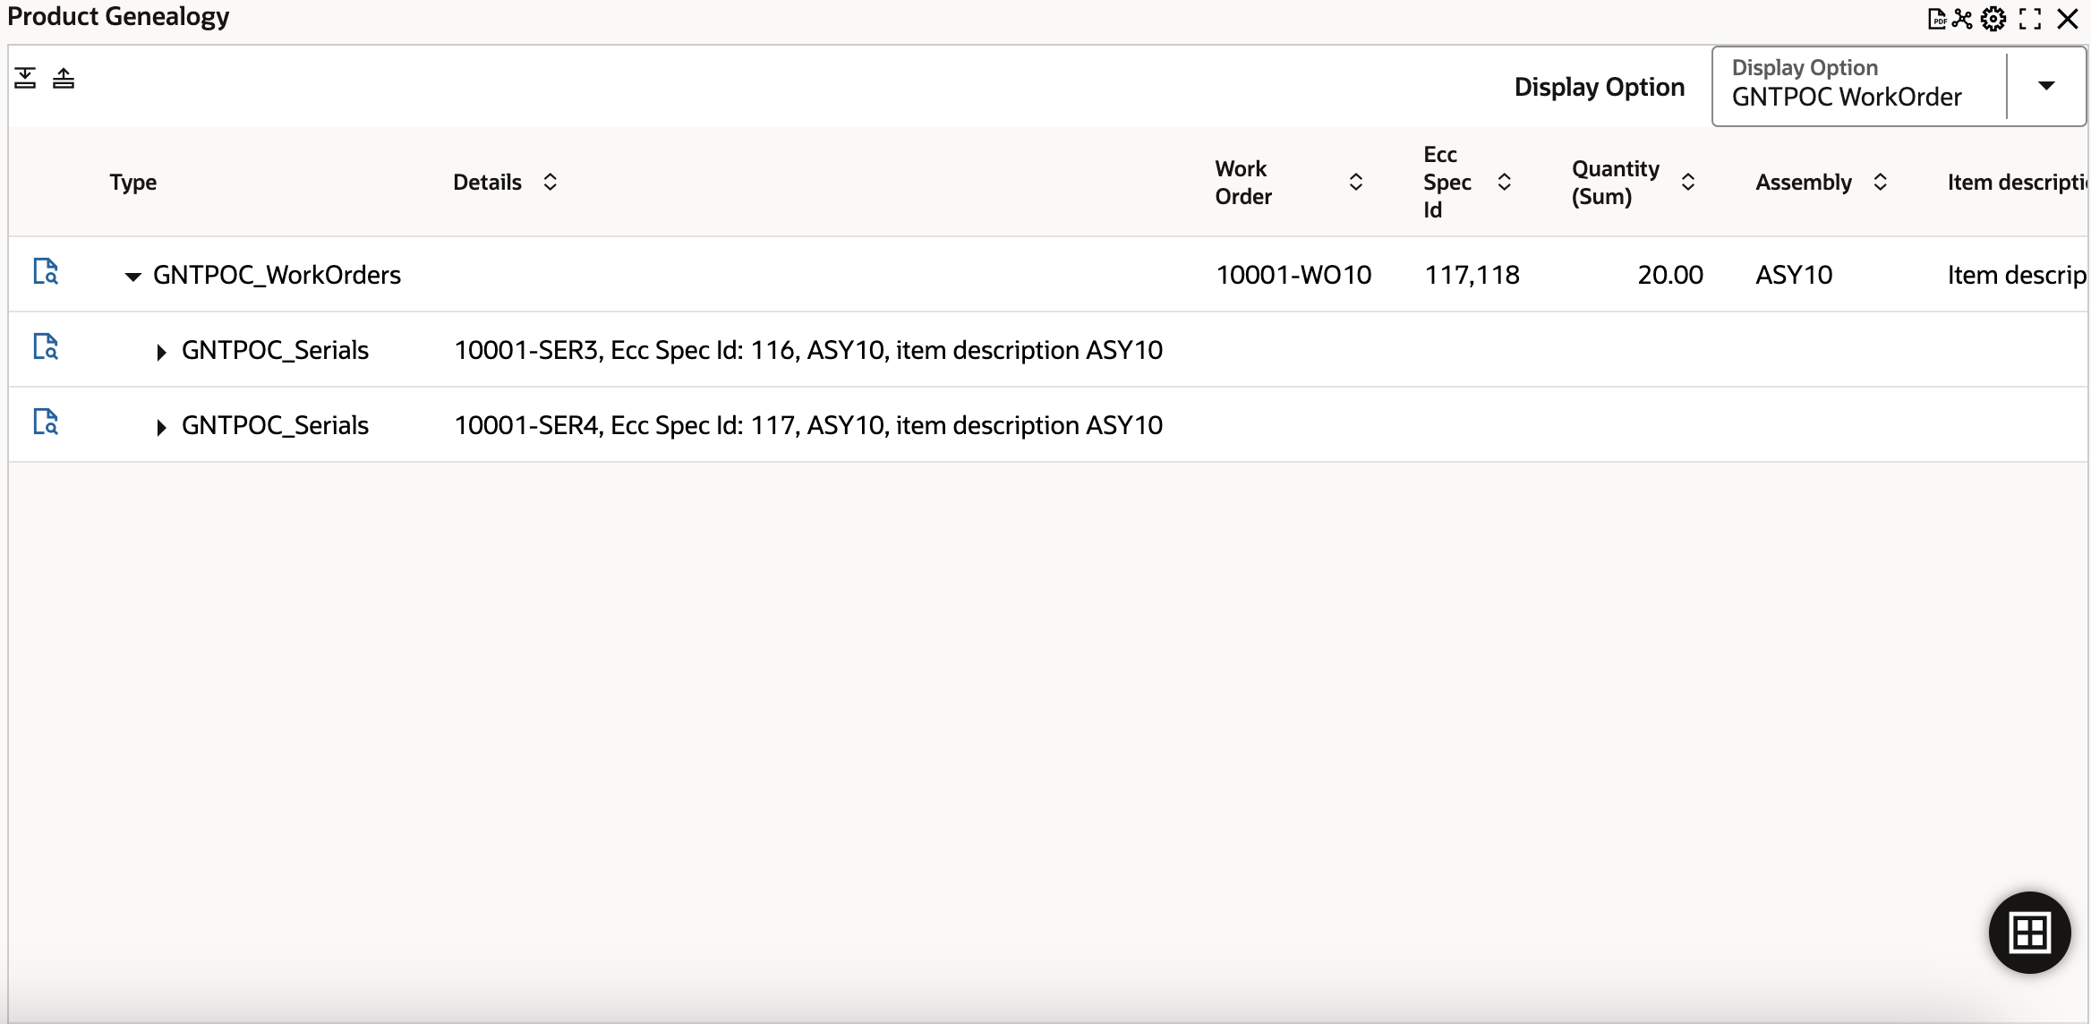





Slide 20
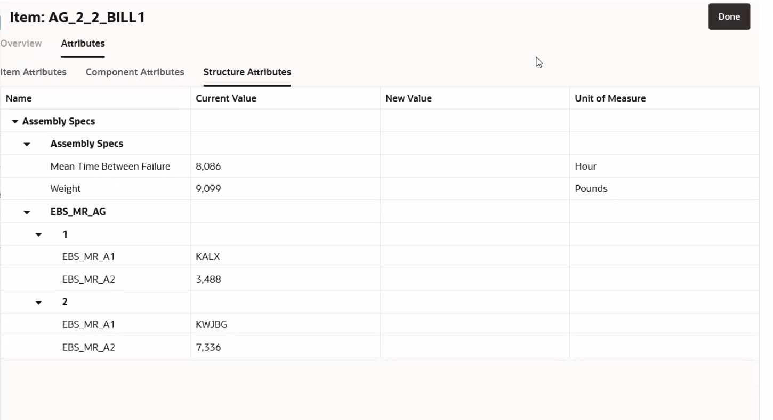

Slide 21
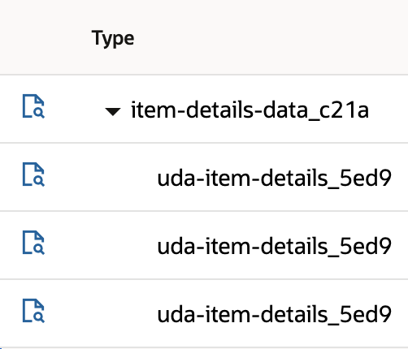

Item Details
Attribute group 1
Attribute group 2
Attribute group 3

Slide 22
Item Details
Attribute group 1
Attribute group 2
Attribute group 3

Slide 23
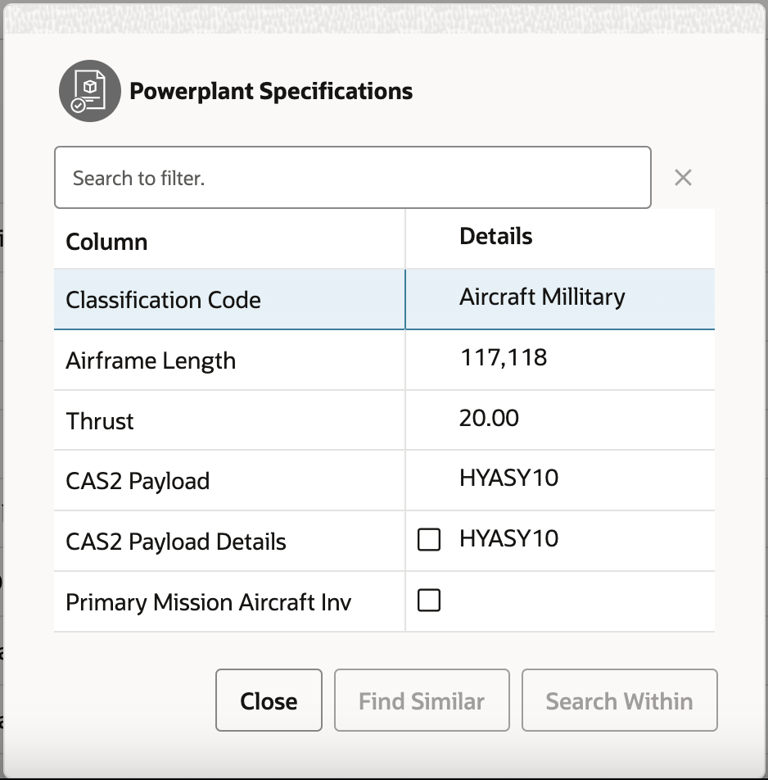

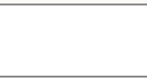



Item Details
Attribute group 1
Attribute group 2
Attribute group 3

Slide 24
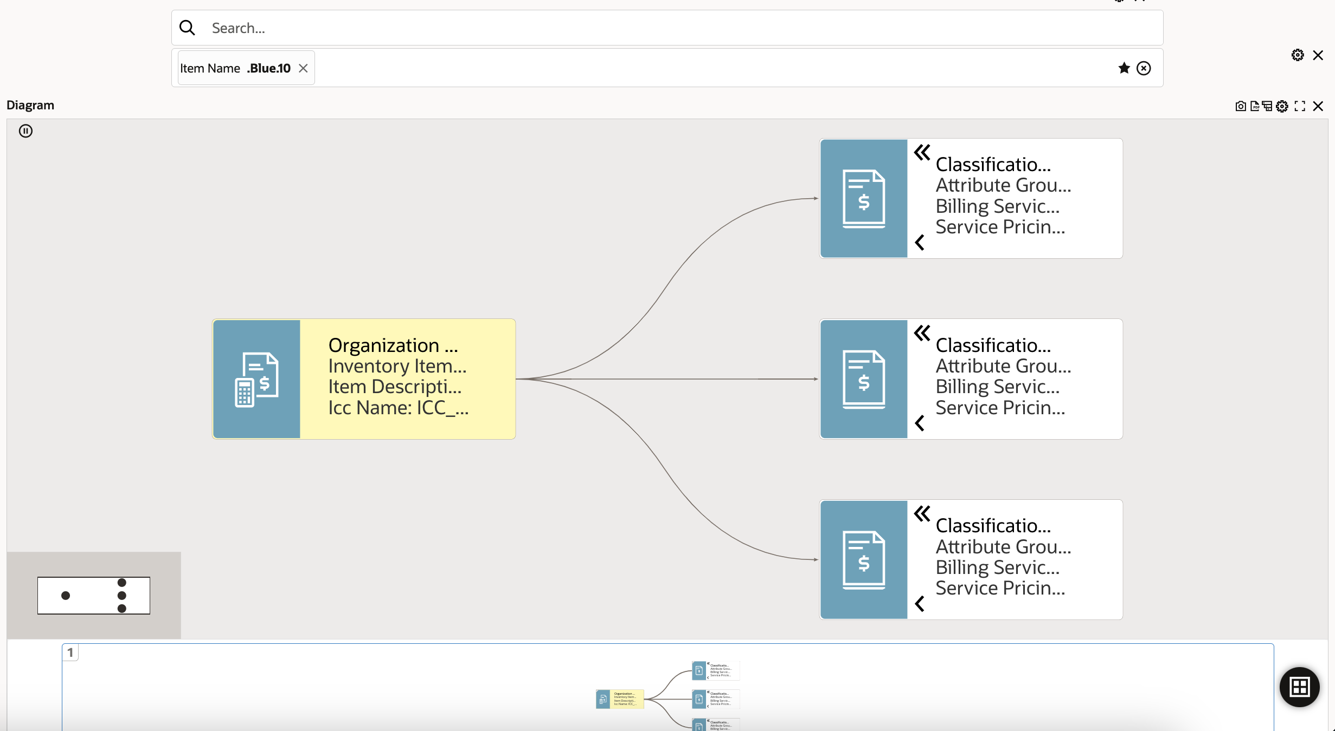

Slide 25
Item Details

Slide 29



Slide 31
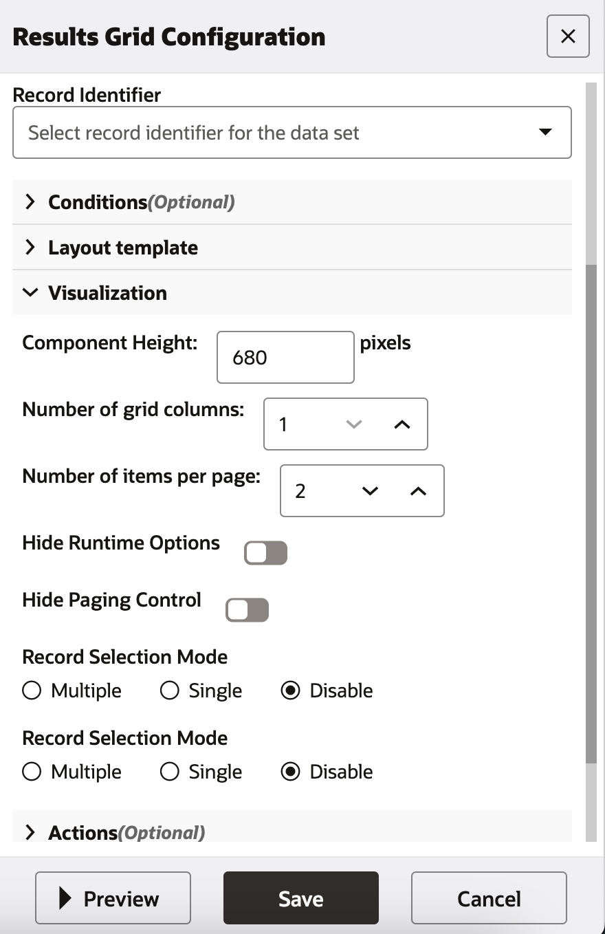


Slide 32
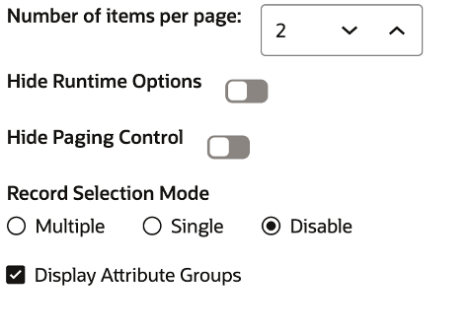

Slide 33
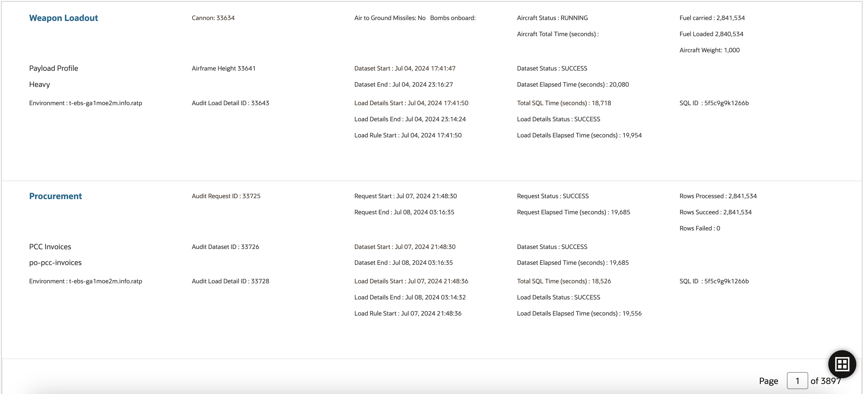
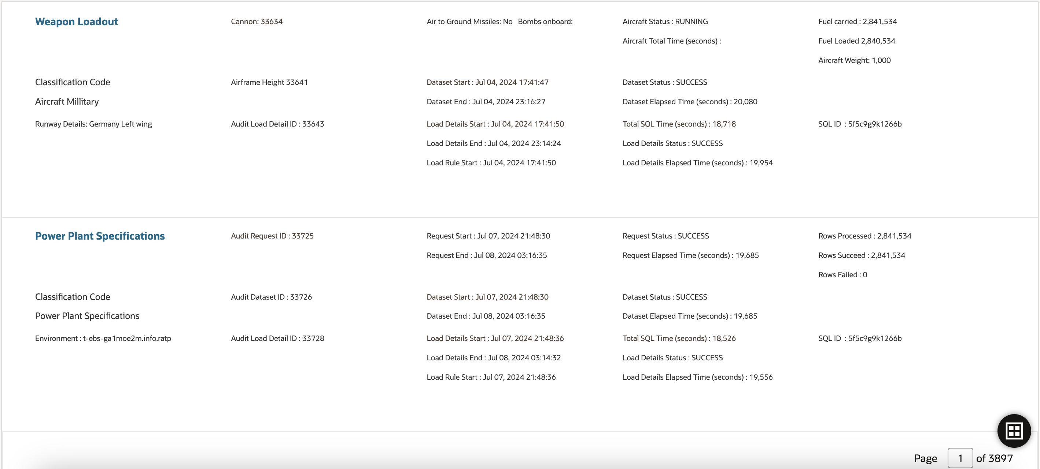



Slide 34
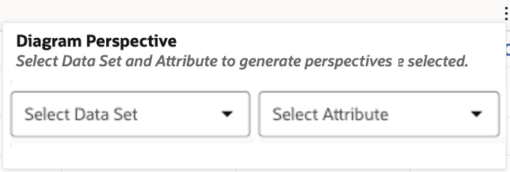
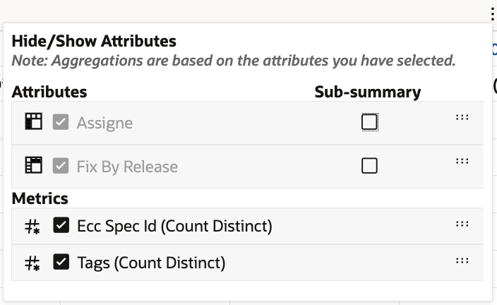





Slide 35
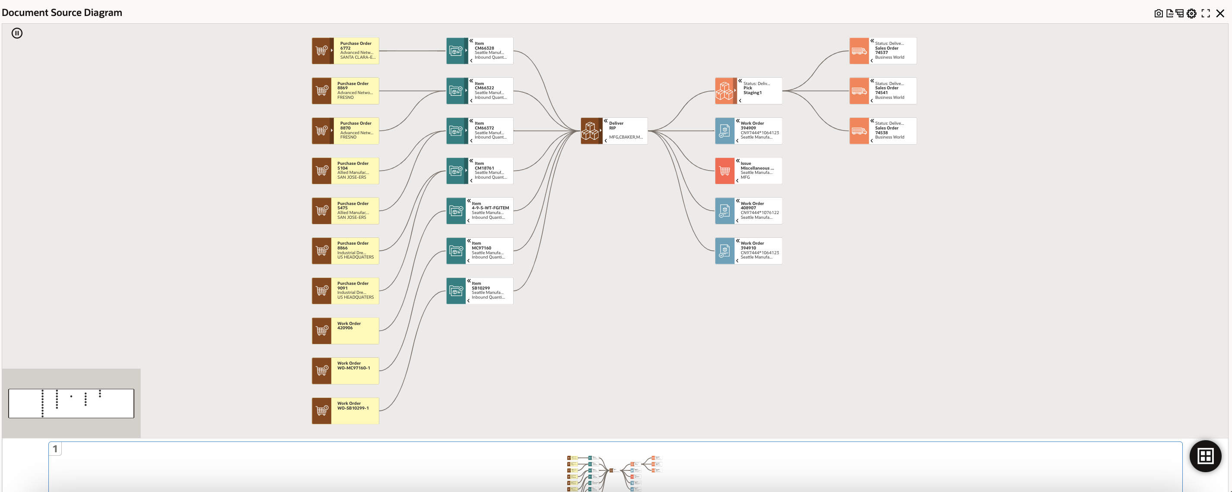

Slide 36



Slide 37
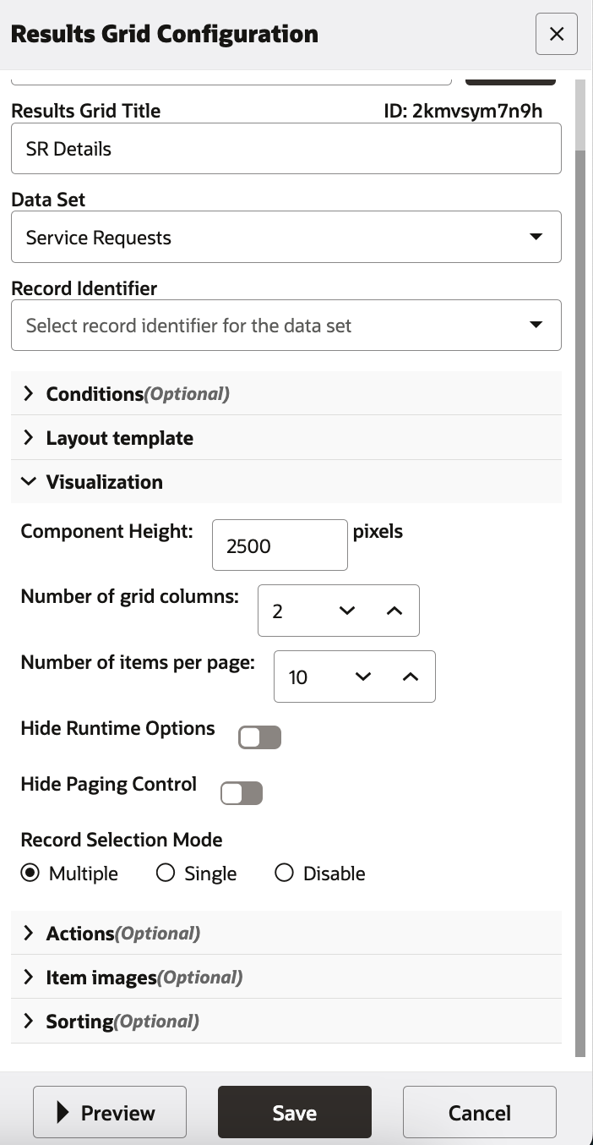




Slide 39
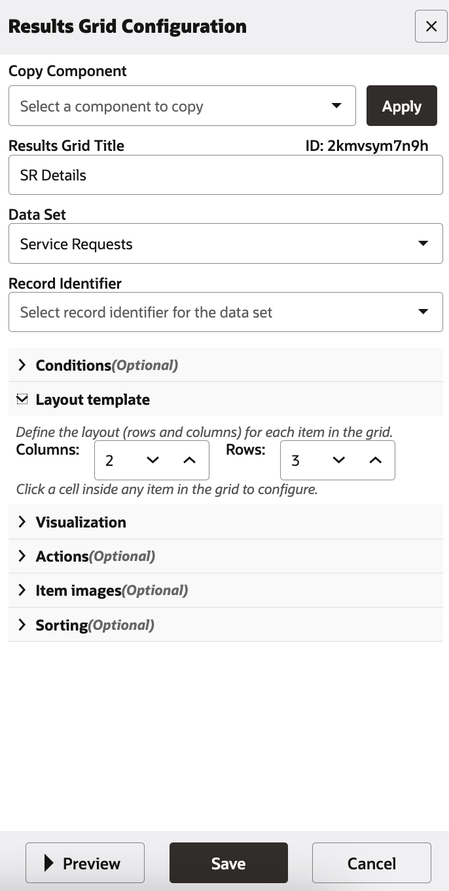
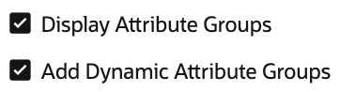





Slide 40
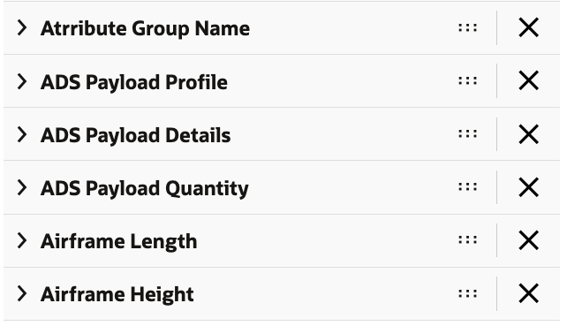

Slide 41
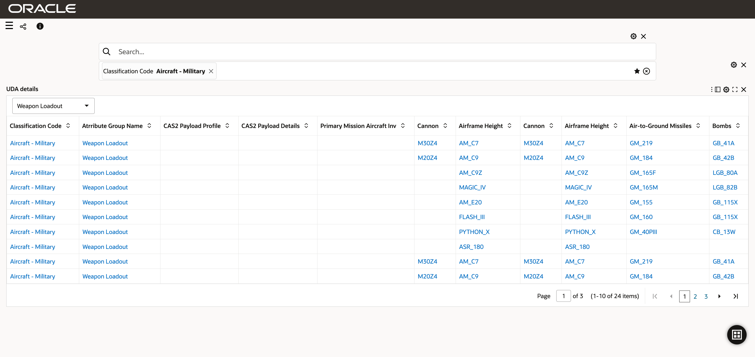
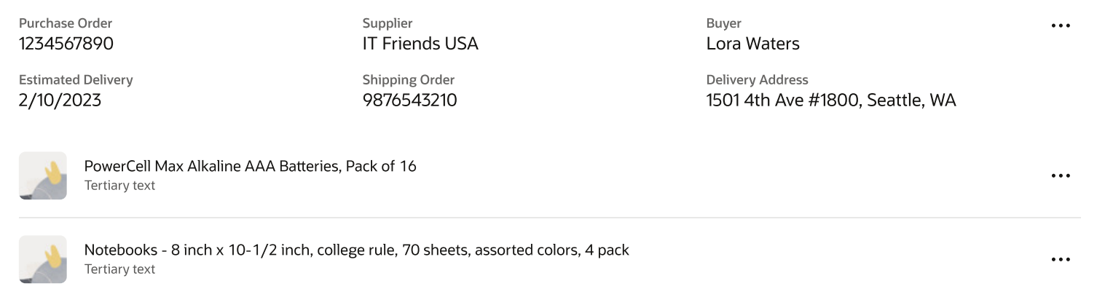


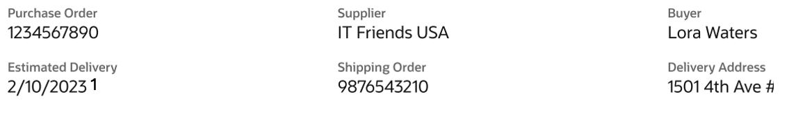


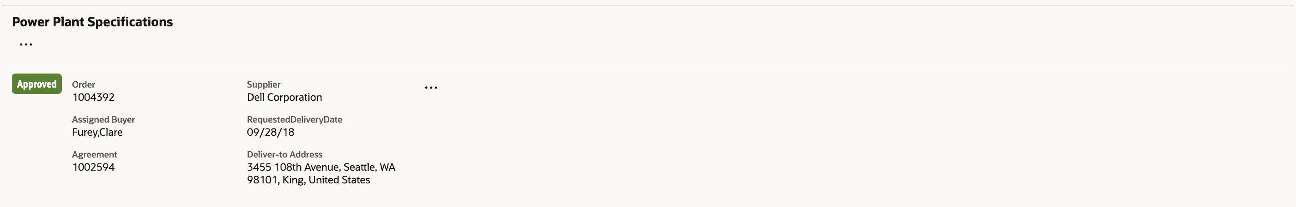


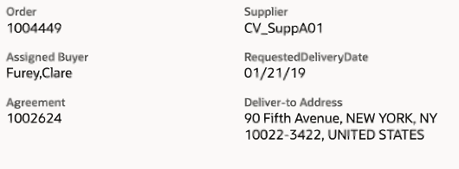
Classification Code
Attribute Group Name
Bombs
Carrier
Runway Distance
Fuel
Aircraft Military
Weapon Loadout
MTYR56
HMS Queen
1200 Meters
300000
1
Delivery Date
Capacity
Cannon
Payload Profile
Airframe Height
Airframe Width
09/12/2020
300000
MYUTR
Registration Number
Serial Number
Type
Country
Engine Type
Range
N12345
123456
Boeing 737
USA
CFM56-7B
5200 Nautical Miles

Slide 42

1

Slide 43
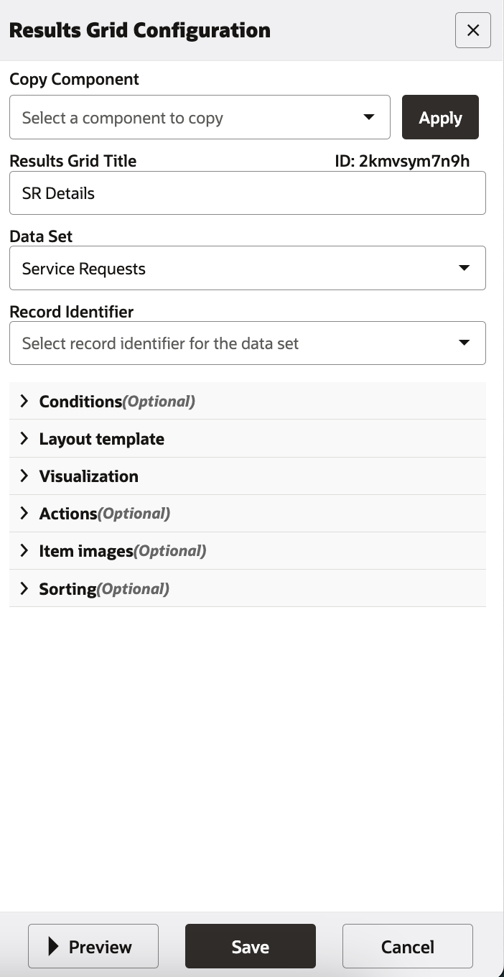
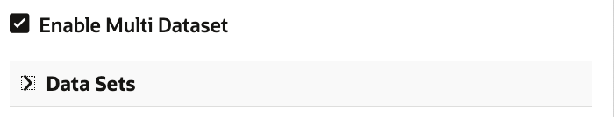

Slide 44
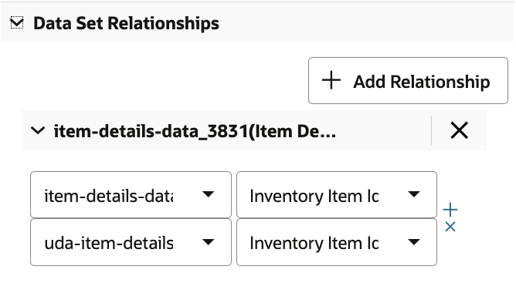

Slide 45



Slide 46

Number of Group Item Header columns:
Number of Group Item Child columns

Slide 47
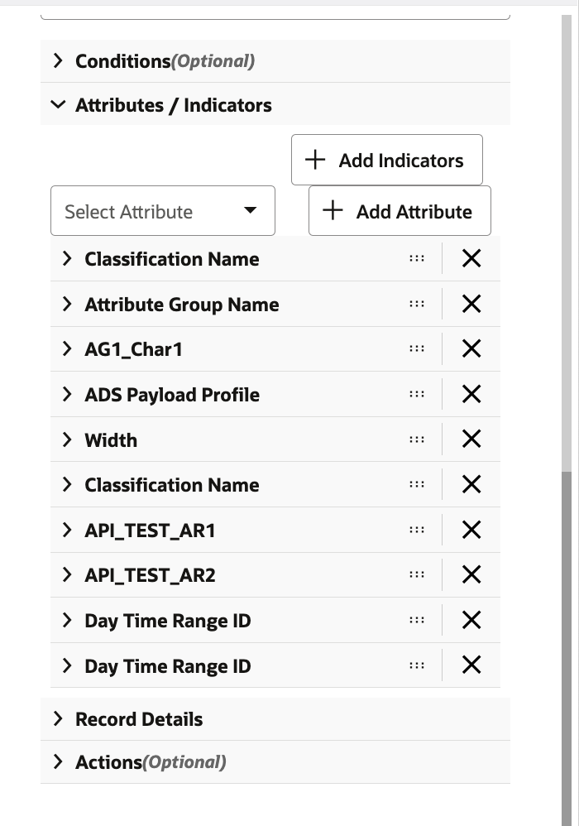
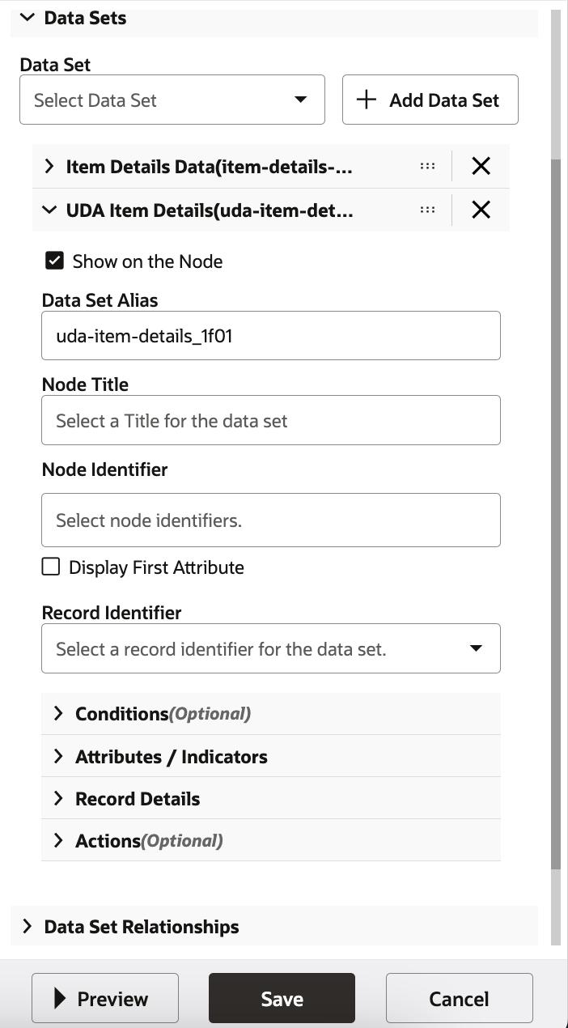



Slide 48
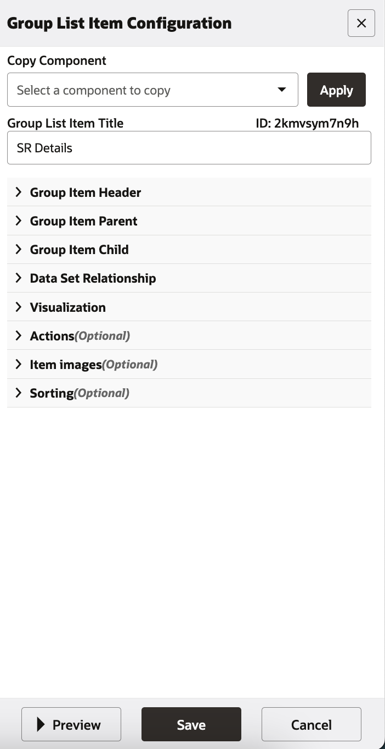

Slide 49
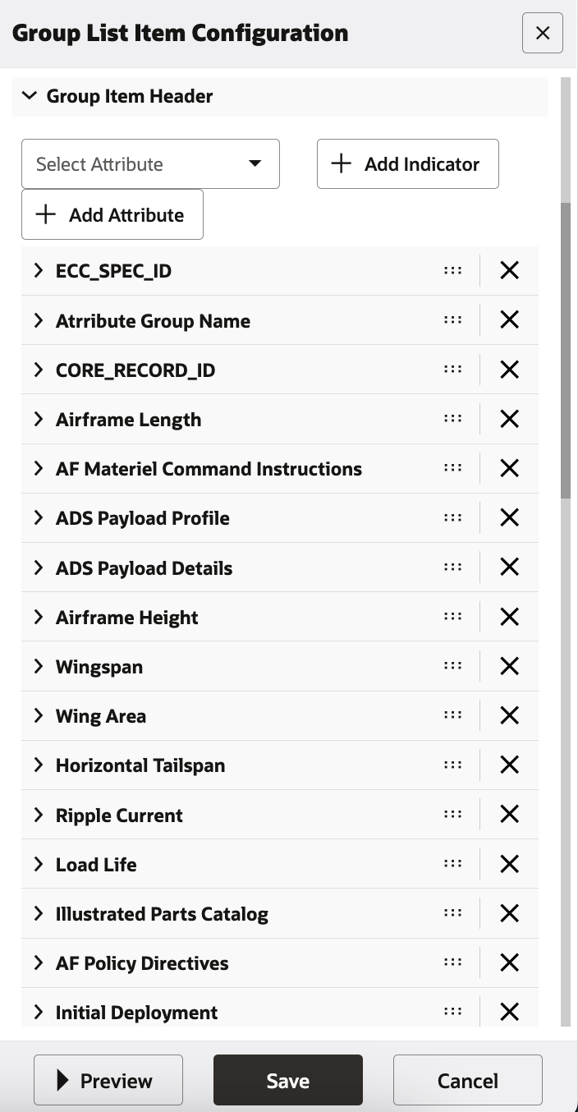
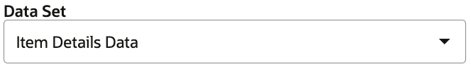
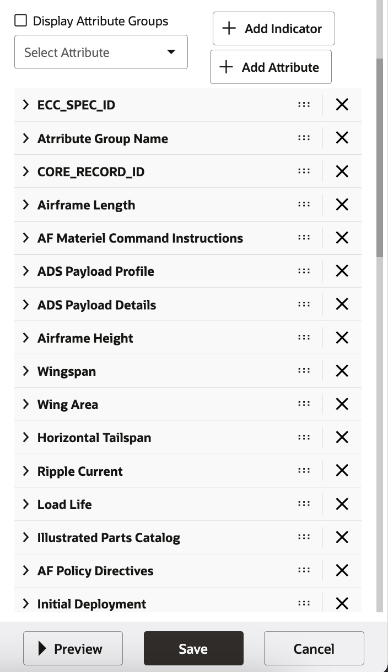

Slide 50
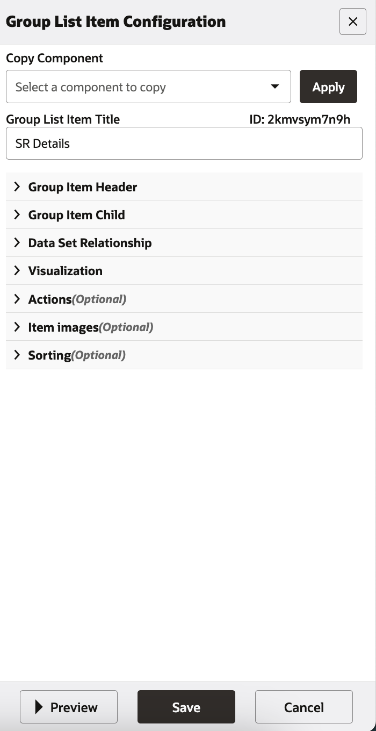
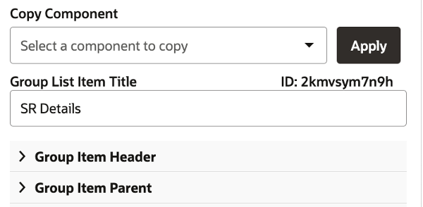

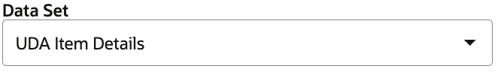
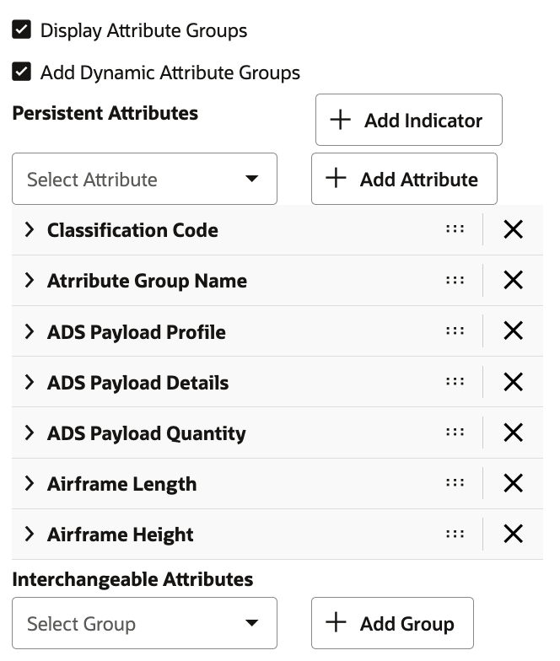

Slide 51
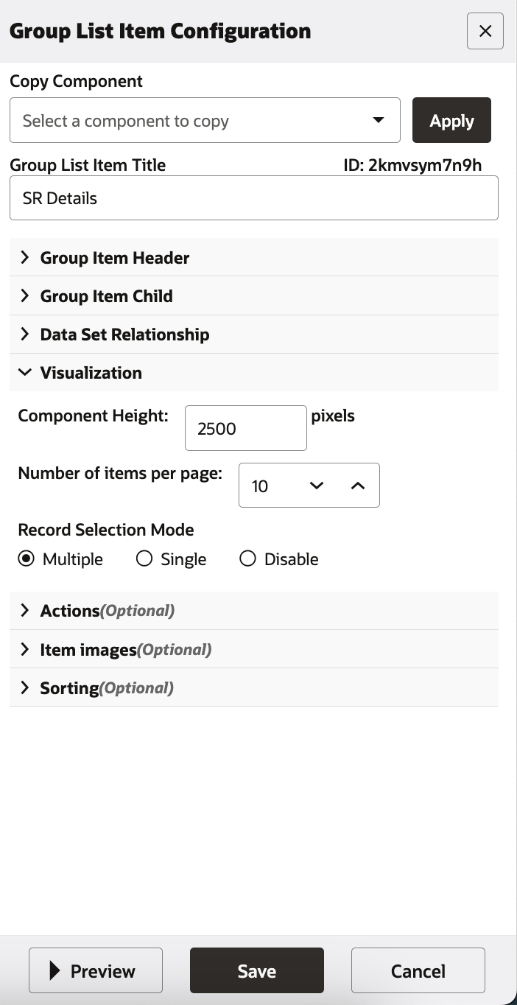

Number of Group Item Header columns:
5
Number of Group Item Parent columns
7
Number of Group Item Child columns
0
1

Slide 52

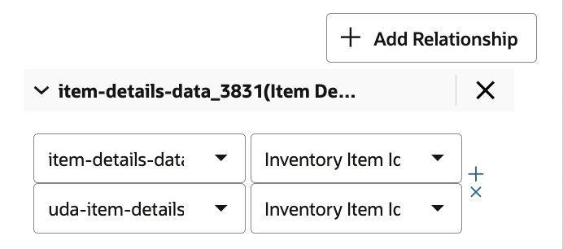

Slide 53


Slide 54



Item Name
Item Description
Buyer
Agreement Number
Delivery Date
V10462
Weapons
Jones, Spark
103781
09/13/2020
1
Weapon Loadout
Capacitor Specifications
Capacitor Packaging Specs
Power Plant Specifications

Slide 55






Item Name
Item Description
Buyer
Agreement Number
Delivery Date
V10462
Weapons
Jones, Spark
103781
09/13/2020
1
Weapon Loadout
Capacitor Specifications
Capacitor Packaging Specs
Power Plant Specifications

Slide 56

Item Name
Item Description
Buyer
Agreement Number
Delivery Date
V10462
Weapons
Jones, Spark
103781
09/13/2020
Weapon Loadout
Classification Code
Attribute Group Name
Bombs
Carrier
Runway Distance
Fuel
Aircraft Military
Weapon Loadout
CB_13W
HMS Queen
1200 Meters
300000
Delivery Date
Capacity
Cannon
Payload Profile
Airframe Height
Airframe Width
09/12/2020
300000
MYUTR

Slide 57

Item Name
Item Description
Buyer
Agreement Number
Delivery Date
V10462
Weapons
Jones, Spark
103781
09/13/2020
Weapon Loadout
Classification Code
Attribute Group Name
Bombs
Carrier
Runway Distance
Fuel
Aircraft Military
Weapon Loadout
CB_13W
HMS Queen
1200 Meters
300000
Delivery Date
Capacity
Cannon
Payload Profile
Airframe Height
Airframe Width
09/12/2020
300000
MYUTR

Slide 58

Item Name
Item Description
Buyer
Agreement Number
Delivery Date
V10462
Weapons
Jones, Spark
103781
09/13/2020
1
Weapon Loadout
Classification Code
Attribute Group Name
Bombs
Carrier
Runway Distance
Fuel
Aircraft Military
Weapon Loadout
MTYR56
HMS Queen
1200 Meters
300000
Delivery Date
Capacity
Cannon
Payload Profile
Airframe Height
Airframe Width
09/12/2020
300000
MYUTR

Slide 59


Item Name
Item Description
Buyer
Agreement Number
Delivery Date
V10462
Weapons
Jones, Spark
103781
09/13/2020
1
Compliance
Classification Code
Attribute Group Name
Dielectric
ESR Type
ESR Value
Battery Life
Capacitors
Compliance
Ceramic
HYG Fairland
0.1
2 Years
Classification Code
Attribute Group Name
Dielectric
ESR Type
ESR Value
Battery Life
Capacitors
Compliance
Ceramic
HYG Fairland
0.2
6 Years
Classification Code
Attribute Group Name
Dielectric
ESR Type
ESR Value
Battery Life
Capacitors
Compliance
Ceramic
UFG Mainframe
0.1
4 Years

Slide 60

Item Name
Item Description
Buyer
Agreement Number
Delivery Date
V10462
Weapons
Jones, Spark
103781
09/13/2020
1
Weapon Loadout
Classification Code
Attribute Group Name
Dielectric
ESR Type
ESR Value
Battery Life
Capacitors
Compliance
Ceramic
HYG Fairland
0.1
2 Years
Voltage Rating
Capacitance
Tolerance
Package Type
RoHS Compliance
Lead Spacing
250V DC
150 uF
10%
Radial
Yes
5 mm
Classification Code
Attribute Group Name
Dielectric
ESR Type
ESR Value
Battery Life
Capacitors
Compliance
Ceramic
HYG Fairland
0.1
6 Years
Classification Code
Attribute Group Name
Dielectric
ESR Type
ESR Value
Battery Life
Capacitors
Compliance
Ceramic
UFG Mainframe
0.1
4 Years

Slide 61
Item Name
Item Description
Buyer
Agreement Number
Delivery Date
V10462
Weapons
Jones, Spark
103781
09/13/2020
1
Weapon Loadout
Classification Code
Attribute Group Name
Dielectric
ESR Type
ESR Value
Battery Life
Capacitors
Compliance
Ceramic
HYG Fairland
0.1
2 Years
Voltage Rating
Capacitance
Tolerance
Package Type
RoHS Compliance
Lead Spacing
250V DC
150 uF
10%
Radial
Yes
5 mm
Classification Code
Attribute Group Name
Dielectric
ESR Type
ESR Value
Battery Life
Capacitors
Compliance
Ceramic
HYG Fairland
0.1
6 Years
Classification Code
Attribute Group Name
Dielectric
ESR Type
ESR Value
Battery Life
Capacitors
Compliance
Ceramic
UFG Mainframe
0.1

Slide 62


Item Name
Item Description
Buyer
Agreement Number
Delivery Date
Price
V10462
Weapons
Jones, Spark
103781
09/13/2020
$20000
Classification Code
Attribute Group Name
Bombs
Carrier
Runway Distance
Fuel
Aircraft Military
Weapon Loadout
MTYR56
HMS Queen
1200 Meters
300000 Gallons
Delivery Date
Capacity
Cannon
Payload Profile
Airframe Height
Airframe Width
09/12/2020
300000 Gallons
MYUTR

Slide 63



Slide 64


Columns:
7

Slide 65


Slide 69



Slide 71



